Slide 1
The Generic Automation Framework based on BDD V Rama Prasada Reddy
Global Product Engineering and Lifecycle Services Company
Notes:
Talking points:
We have built QuEST over the last 21 years as a aspiration driven organization. We continue to push the boundaries, create new frontiers across multiple safety critical and hi-tech industries we serve. We do this by offering our Customers a range of Services and Solutions and engagement models that spans – Engineering, Enterprise solutions, Operations, Supply Chain and Technology enabled solutions covering the complete product lifecycle.
As such, QuEST is a Leading Global Product Engineering and Lifecycle Services Company
In this presentation we will cover 3 aspects of QuEST.
WHO we are, WHAT we do and for WHOM, and why we are in business – our purpose
Then we move on to HOW we engage with Customers
Finally we will cover HOW we are different and can add unique value to you and help you “Create the Frontier”

Slide 2
Scope
OutCome
Manual cases mapping to Automation script involves cost
As web site undergoes changes, if framework is not general then it involves changing lot of code
Problem Statement
Problem
Manual cases to Automation involves cost
As web site undergoes changes, if framework is not general then it involves changing lot of
Approach
Define roles( Automation Framework expert, Executor and Domain expert )
Define Generalized framework to handle the changes of web site
Outcome
Generalized Automation Framework based on BDD
The common identified scenarios applicable to any type of Web App
These scenario can be used across any Web App and driven by feature files
Notes:
created by http://slidehunter.com
Picture from https://www.pexels.com/photo/man-in-white-and-black-striped-shirt-119705/

Slide 3
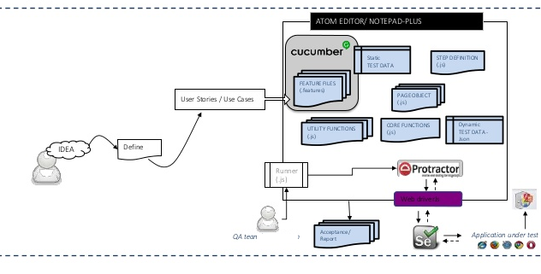
Test Automation Framework - 1
Notes:
System Architecture: Outline & detail the basic architecture of prototyped solution with the help of block diagrams, etc. if any

Slide 4
Test Automation Framework - 2
| .gitignore
| .npmrc
| package-lock.json
| package.json
| README.md
| tsconfig.json
| tslint.json
|
+---core
| |
| +---logger
| | step-logger.ts
|
+---e2e
| +---components
| | +---devfactory
| | | \---component-helpers
| | | component-helpers.ts
| | |
| | +---html
| | | button-helper.ts
| | | checkbox-helper.ts
| | | dropdown-helper.ts
| | | element-helper.ts
| | | page-helper.ts
| | | textbox-helper.ts
| | | wait-helper.ts
| | |
| | +---misc-utils
| | | constants.ts
| | | html-helper.ts
| | | js-helper.ts
| | | json-helper.ts
| | | validation-helper.ts
| |
| +---config
| | e2e.conf.json
| | protractor.conf.ts
| |
| +---features
| | Demo.feature
| |
| +---page-objects
| | | common.json
| | | pages.json
| | |
| | +---pages
| | | Google_Search.json
| | | home_page.json
| | |
| | \---TestCasesData
| | home_Test_Case_1.json
| +---stepdefinitions
| | background.ts
| | click.ts
| | hotkeys.ts
| | input.ts
| | navigate.ts
| | wait.ts
| |
| \---stephelpers
| backgroudHelper.ts
| dataHelper.ts
| elementHelper.ts
| pageHelper.ts
Notes:
System Architecture: Outline & detail the basic architecture of prototyped solution with the help of block diagrams, etc. if any

Slide 5
Sample Common Scenarios Used Across Any Web APP --
verify-element-presence
Then the "(1st|2nd|3rd|[0-9]+th)" "([^"])" (does not )?contains? the "([^"])" element
Then the "(1st|2nd|3rd|[0-9]+th)" "([^"])" for specific "([^"])" (does not )?contains? the "([^"]*)" element
verify-page
Then I should be on the "([^"]*)" page
Then I see the "([^"]*)" page title
alerts
When I (accept)?( dismiss)? the alert dialog
click
When I click the "([^"]*)" (?:button|link|icon|element|radio button)
When I click the "(1st|2nd|3rd|[0-9]+th)" "([^"]*)" (?:button|link|icon|element)
Notes:
System Architecture: Outline & detail the basic architecture of prototyped solution with the help of block diagrams, etc. if any

Slide 6
Technology Choices
Sl. No. | Technologies used | Rationale for selection
1 | Cucumber | Its BDD framework, through which we can support general business interactions with respect to web app
2 | Protractor | It will be used for both Angular and None Angular Web app
3 | Node and NPM | To provide java script run time environment
4 | Type Script | To provide OOPS concepts in most easy way of understanding
5 | TSC | Translator from Type script to java script to run by Node environment
6 | Java Script | To have java script compiled by tsc from Type Script and run in Node environment.
7 | Gherkin | Language to be used with Cucumber
Notes:
Technology Choice: Add technologies used and rationale for selecting so

Slide 7
Driver Snip
Feature: As an Generic automation framework giving demo feature Background: Given I navigate to the URL "home page" Then I wait "Google" title loaded Then I set "Failure" state of Execution @desktop @smoke @automation_framework_demo1 Scenario Outline: As an Generic automation framework giving demo scenario - 1 When I fill in the "Google Input" input with "<TestCase>" and key value "<Input>" Then I wait "10" seconds When I press the enter key Then I wait "10" seconds Then I navigate to the "Google Search" page Then I click the "Google Button" button Then I set "<SuccessStateAfter>" state of Execution Examples: | TestCase | Input | SuccessStateAfter | | home_Test_Case_1 | Google Input1 | Success | | home_Test_Case_1 | Google Input2 | Failure | @desktop @smoke @automation_framework_demo2 Scenario Outline: As an Generic automation framework giving demo scenario - 2 When I fill in the "Google Input" input with "<TestCase>" and key value "<Input>" Then I wait "10" seconds When I press the enter key Then I wait "10" seconds Then I navigate to the "Google Search" page Then I click the "Google Button" button Then I set "<SuccessStateAfter>" state of Execution Examples: | TestCase | Input | SuccessStateAfter | | home_Test_Case_1 | Google Input3 | Success | | home_Test_Case_1 | Google Input4 | Failure |
Notes:
Product Deployment: How the Solution Can be Deployed? -- Target Environment, What is needed, etc.
Value Added to QuEST: Business Benefits? -- How QuEST can benefit; be specific about customer, VBU etc.

Slide 8
Pages & Locator Snips & Data Snips
Pages.json
{ "home page" : "http://www.google.com/", "Google Search": "/search" }
Pages → ( Respective Page json files having locators of that page )
home_page.json
{ "Google Input" : ["xpath", "//input[@name='q']"], "Google Search" : ["xpath", "//input[@value='Google Search']//..//..//style/following-sibling::center//input[@value='Google Search’]”] }
Google_Search.json
{
"Google Button" : ["xpath", "//button[@type='sumbit']"],
"Google Input" : ["xpath", "//input[@name='q']"]
}
Notes:
Key Learning: Team Experience, Bottle necks, “Aha” Moments, etc.
Scope for Improvement: How the solution can be improved further?

Slide 9
Data Snips
TestCaseData
home_Test_Case_1.json
{
"Google Input1" : "CPU",
"Google Input2" : "RAM",
"Google Input3" : "HARD DISK",
"Google Input4" : "MONITOR"
}
Notes:
Key Learning: Team Experience, Bottle necks, “Aha” Moments, etc.
Scope for Improvement: How the solution can be improved further?

Slide 10
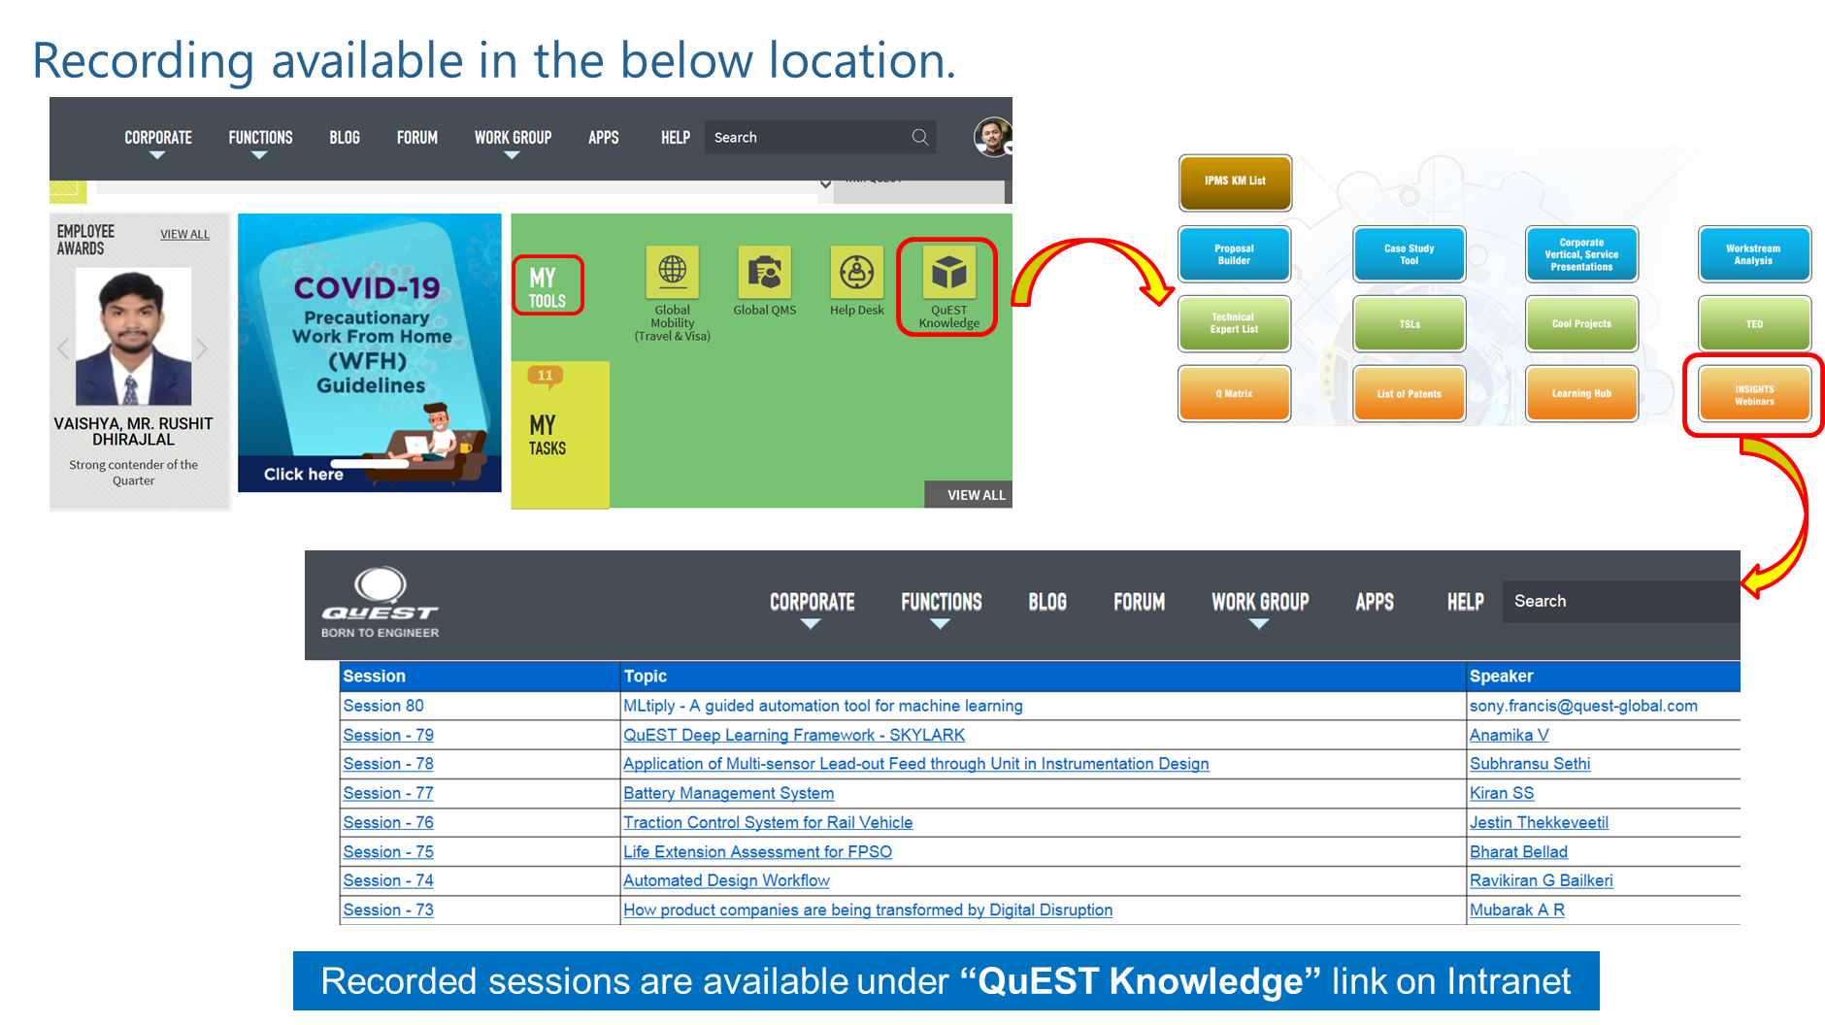
Recording Available in Below Location

Slide 11
Thank You
Engineering | Enterprise Solutions | Operations & Supply Chain | Technology & Digital Solutions

